Slide 1
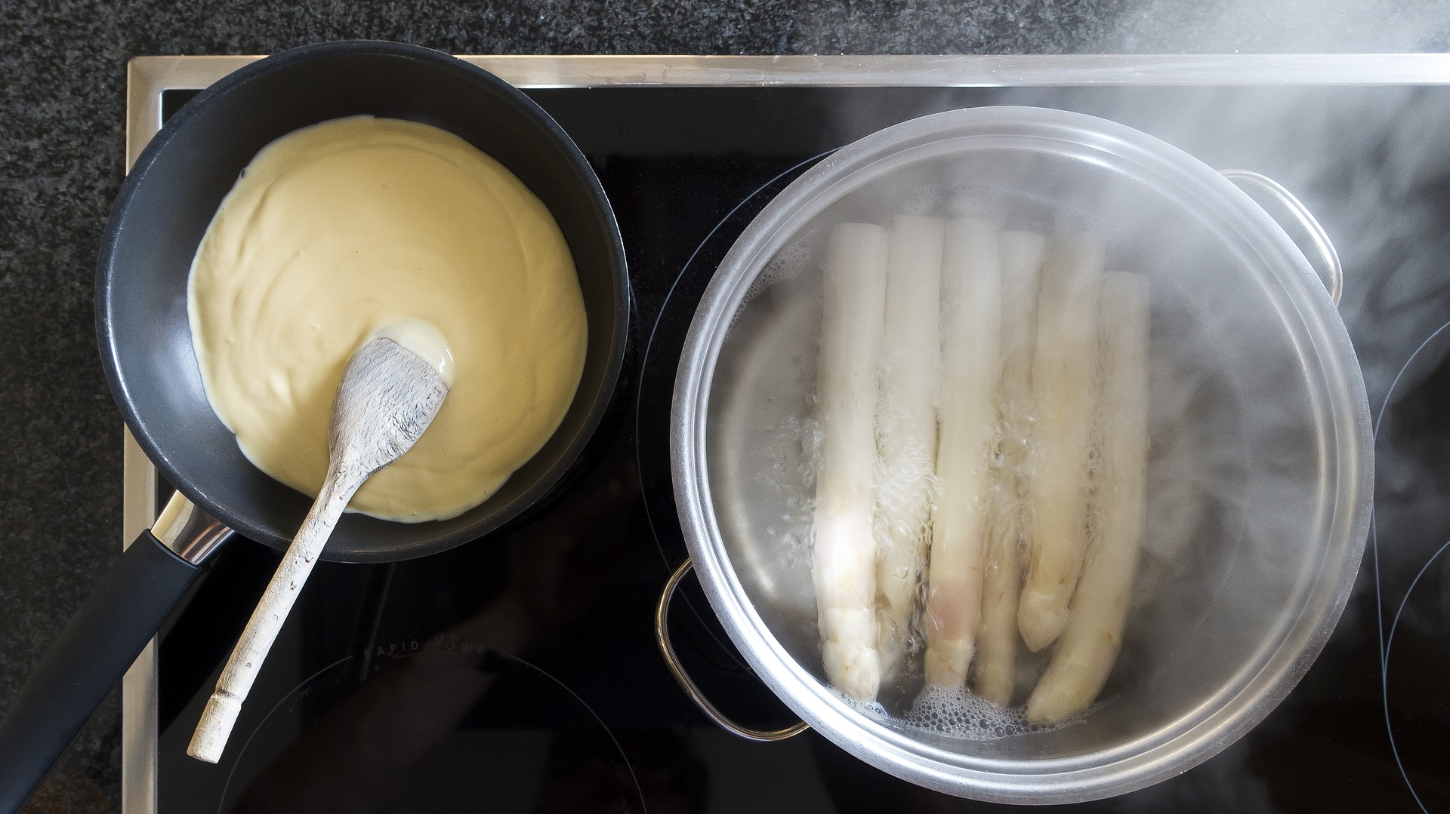
Taste the Future
and transition to a clean energy home
Notes:
Welcome everyone to Taste the Future.

Slide 2
Created by HEET & Mothers Out Front
Notes:
Created by HEET and Mothers out Front (and add any sponsors or event hosts here - and hosted by…..)

Slide 3
Induction Cooking
Notes:
Induction cooking – the reason we’re here today. The speed and heat we love from cooking with Gas, but cleaner… and FASTER!

Slide 4
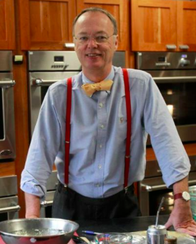
Ming Tsai
Blue Dragon
Chris Kimball
America’s Test Kitchen
Dominique Crenn
Atelier Crenn and Petit Crenn
“I’ve been using it for 20 years.”
“Don’t consider it, just buy.”
“It’s better and cleaner than gas.”
Notes:
All the cool chefs use this method. in Europe they’ve been using it for more than 20 years.

Slide 5
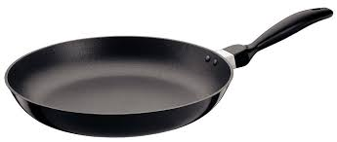
How it works
Electromagnet in stove moves electrons in your pan to create heat.
The pan becomes the burner.
Notes:
Electromagnet moves the electrons in the pan really quickly left and then right and then right, and same as rubbing your hands together for a while, all that movement and friction causes heat.
The pan gets hot. It is the burner

Slide 6
Induction is: Fast, Safe and Precise
Notes:
Unlike with gas stoves, where the heat is moved from the flame to the air to the pan to the food, wIth Induction, the heat moves directly from the pan to the food.
ALSO, it is SAFER…. Describe.

Slide 7
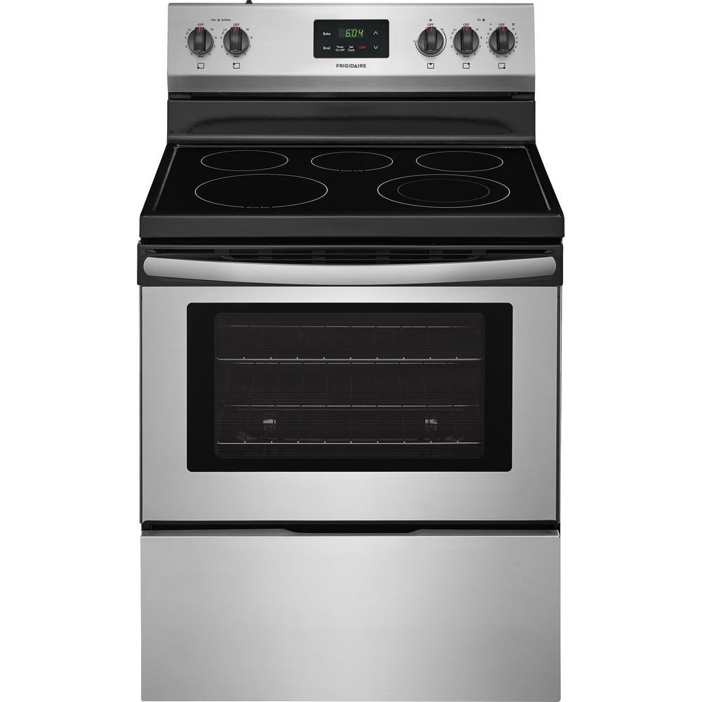
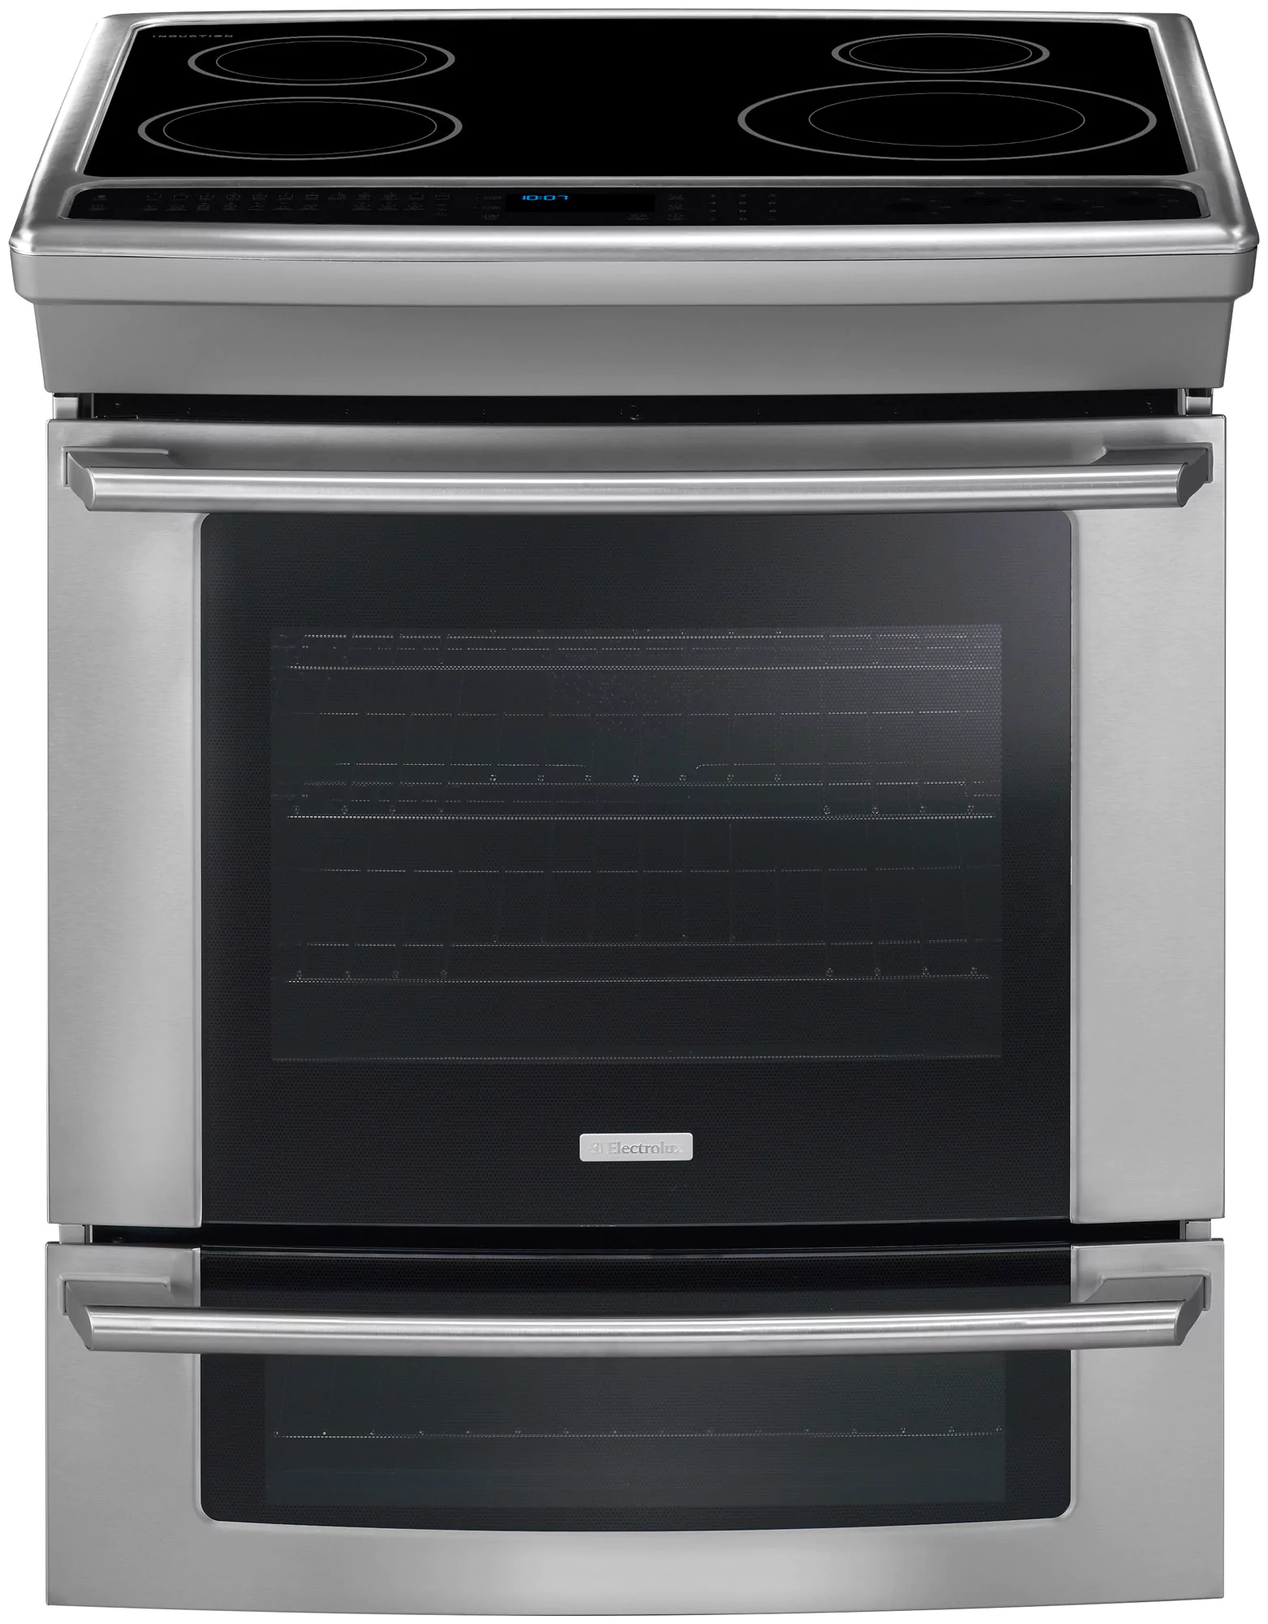
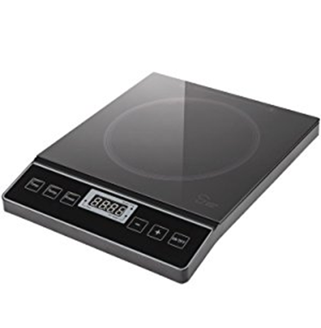
Wide Variety of Options & Prices
Stove Top
$890- $6,000
Induction
$900 - $7,000
Conventional Electric
$500- $2,000
Images:
Electric, Frigidaire, Home Depot for $498
Induction: 30” Electrolux, Sears, $2130
Portable single or double burner
$50-500
Notes:
The costs start at $50 for a portable burner you plug into the wall and place on any counter, up to $7,000 for a top of the line induction stovetop with electric oven.
Ikea is now selling a stovetop that is inset in your counter for $895.
Home Depot now sells an induction range for $900.
Extras:
In general, low end induction stoves are twice as expensive as a low end gas stove. But you’re getting cleaner air and less likely to blow up your home.
Gas stove - $450 to $6500 for viking gas stove.

Slide 8
Fracked Gas
(Chemically extracted)
Gas Deposit: Lots of small “bubbles” in shale rock
Method: Water, sand and chemicals pumped in to fracture the rock and release the gas.
Notes:
However this easy-to-reach gas is mostly gone, so now there is fracking. In this case the gas is generally deeper (although not always) and it’s no longer in one big bubble. Instead it’s trapped inside of the shale in many small bubbles. To release the gas, they have to crack the rock formations open by injecting a lot of water, sand and chemicals at enormous pressure.
One question is, what are those chemicals?

Slide 9
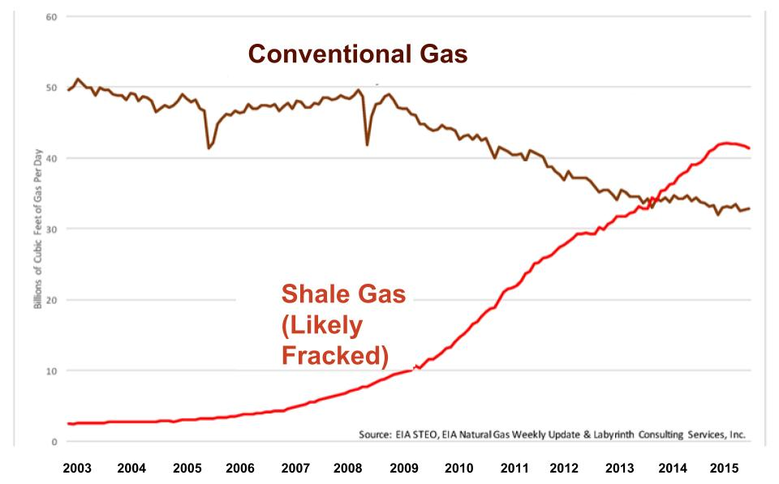
Gas Is Changing Across America
Notes:
Whatever it used to be when we were growing up, it’s changed now. For example, 80% of Mass. gas is now from Marcellus Shale and thus likely fracked.
So, we want to share a different story with you… one of transformation, hope and a bright renewable future. In fact, our goal today is to convince you that the future is exciting, better than you imagined, and it begins now.

Slide 10
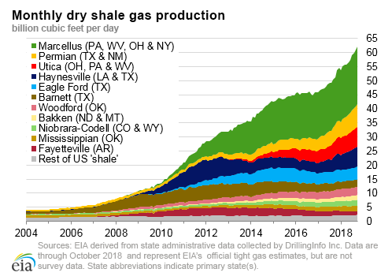
Gas Is Changing Across America
Notes:
And Massachusetts isn’t the only state getting fracked gas.
So, we want to share a different story with you… one of transformation, hope and a bright renewable future. In fact, our goal today is to convince you that the future is exciting, better than you imagined, and it begins now.

Slide 11
But what’s in it?
We’d tell you what’s in it, but then we’d have to let it kill you!
© DesmogBlog.com
Notes:
Strangely, we don’t actually know what we’re getting. Most industries have to report the chemicals they use. But not fracking. Basically because Vice President Cheney was part of Halliburton and Halliburton wanted fracking, he created the “Cheney loophole.” Currently, roughly 20% of fracking chemicals remain undisclosed because they are considered proprietary.
EXTRA INFO
http://www.nytimes.com/2009/11/03/opinion/03tue3.html
explicitly exempted fracking operations from key provisions of the Safe Drinking Water Act
https://www.foodandwaterwatch.org/news/ten-years-later-halliburton-loophole-and-americas-dirty-fracking-boom

Slide 12
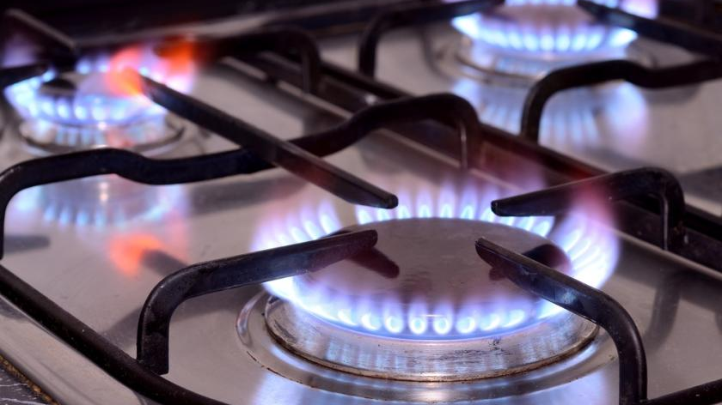
Gas Contaminants found in MA
Notes:
So, people have increasingly been asking us, are any of the fracking chemicals being delivered to our homes with the fracked gas?
To answer that, a group of scientists sampled the gas delivered to people’s homes and ran independent tests for volatile organic compounds. Phase I of this first of its kind study, identified more than 100 volatile organic compounds and now a larger scale Phase II study is in the process of seeking funding. ONE QUARTER of the chemicals initially identified are listed as “non-proprietary” chemicals used in fracking (in the FracFocus Database).
In other words, if you have gas, there is a chance that traces of that fracking stuff are coming into your home. We don’t actually know yet, but will share the results when we have them.

Slide 13
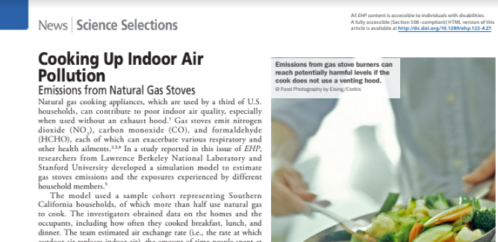
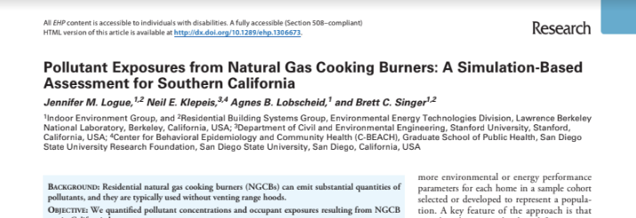
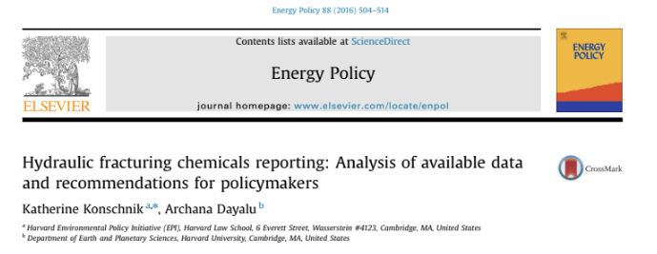
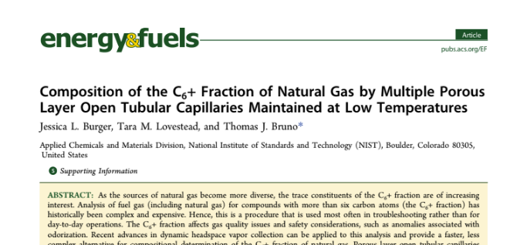
Since the early 2000s, there have been over 900 peer reviewed articles on the health effects.
Notes:
So we don’t know exactly what is being pumped into the ground, into the water and left in the gas.
We can, however, look at the health effects that are connected to gas extraction like fracking and combustion from cookstoves and so on.
Since the early 2000s, there have been over 900 peer reviewed articles on related health effects. Which really isn’t that many – we need to do more research.

Slide 14
Ventilate when using Gas Stoves
Notes:
To be clear, we have no intention of panicking anyone. Just, remember you are, by code, required to ventilate when you’re using a gas stove. Even if the food isn’t burning… PLEASE do. The code is there for a reason.
BUT if you don’t like noisy fans or freezing in the winter, then there is a 3rd option.

Slide 15
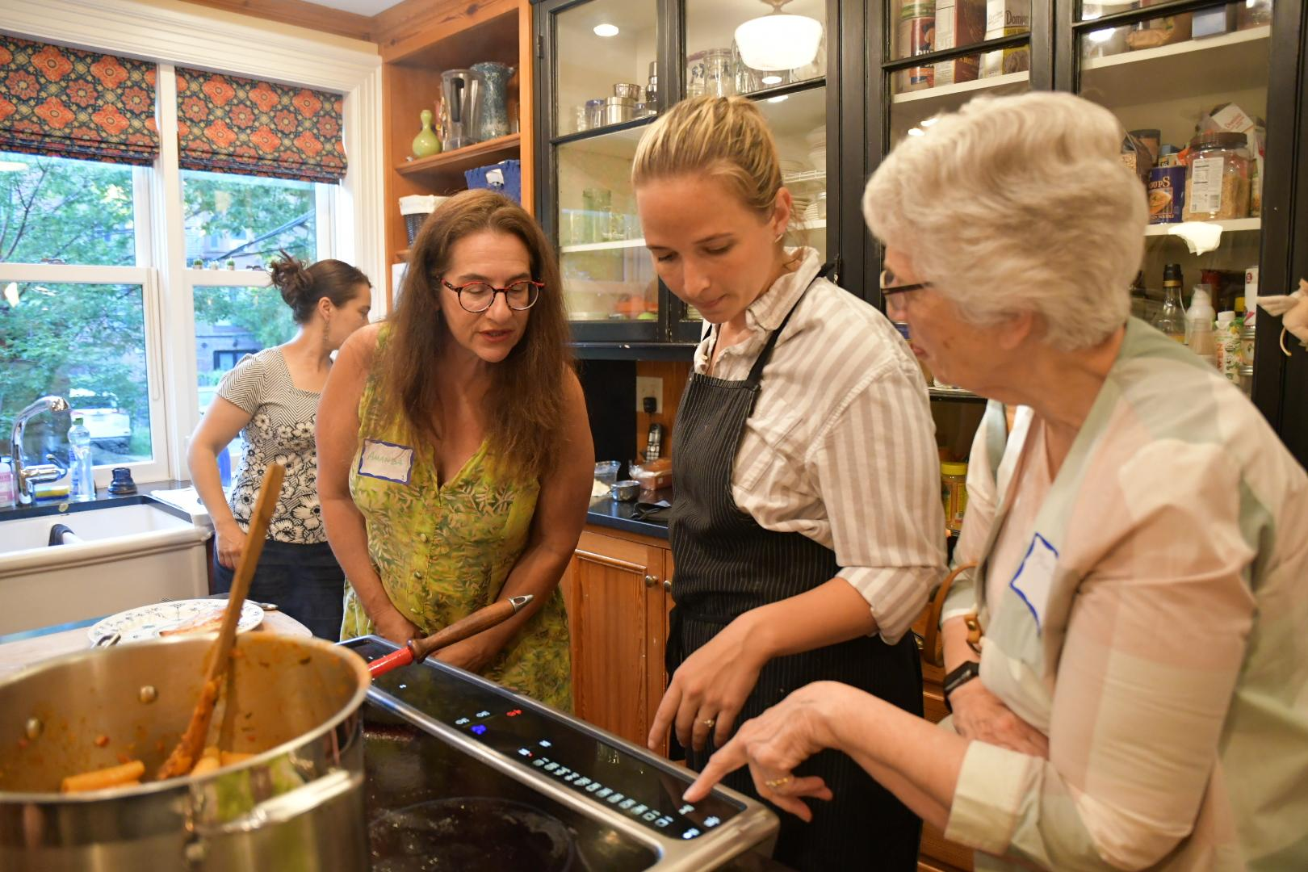
Other Actions...
Host your Own Event
Builds the People Power to...
Taste the Future Events
Notes:
AND, if you want to help us spread the word, consider inviting friends or colleagues to a Taste the Future event of your own.

Slide 16
Build the transition you want
© Knowledge@Wharton - Univ of Pennsylvania
Notes:
So we can all create the transition we want.

Slide 17
Notes:
The moment to thank the host/co-host, helpers and guests.

Slide 18
Notes:
There is a sign up sheet if you would like host a party, if you would like to join Mothers Out Front, if you would like to be on HEETs mailing list… and also of note, HEET currently is looking for xx? more monthly donors in order to get $50K in funding from a local foundation.

